Slide 1
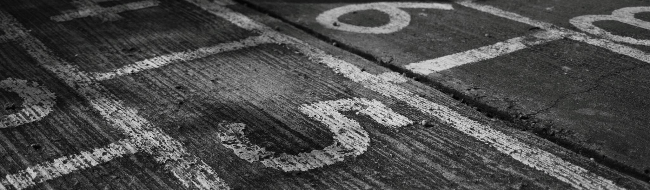
Scorekeeping & Libero Tracking Clinic
Presented by Kristine Petesch
October 27, 2024

Slide 2
Before the match:
Filling out the Scoresheet and the Libero tracking Sheet
Bring your match information with you from Arbitor (names of the team that you know, their positions, the day and time of the match, the home and away teams). Having this information readily accessible when you arrive at the site will help you prepare your sheets.
Aim to be at the match early to fill out the scoresheets or libero tracking sheets, as the goal is to be prepared to enter who is serving immediately after the coin toss. For a best 3 of 5 set match, the first 3 scoresheets and sets in the libero tracking sheet can be filled out before the match even starts, making the transition between sets easier and quicker.
The scorekeeper, the libero tracker, and the scoreboard operator should have a pre-match conversation about what everyone needs and how communication and double checking will happen at the table.
The R2 should also have a pre-match conversation with the table asking what the scorekeeper needs and helping to set the foundation for communication during the match.

Slide 3
Before the match:
Filling out the Scoresheet and the Libero tracking Sheet
Scoresheet Checklist:
  Top of the Scoresheet:
    Site information (school the match is being played at)
    Court number (if this is a regular season match, likely writing “main” or “auxiliary” will work; if this is post-season or a tournament, then there may be a court number)
    Match number (if this is a regular season match, the level of play is usually written here, such as Varsity; if this is post-season or a tournament, then there may be an actual match number)
    Date (day that the match is being played on)
  Middle of the Scoresheet:
    Team names (write the names of each team on which side they are warming up on in the corresponding boxes of the scoresheet). Double check with the R2 if there is concern that they may change before the match starts (more relevant to post-season or tournament play).
    Circle the S to indicate which team is serving after the coin toss in which the R2 has communicated this information.
    Recommendation: In the team name box, additional information may be included, such as the libero number or an alternate captain, which is very applicable if a team indicates a setter as a floor captain and is running a 6-2 or if the libero is indicated as the starting floor captain. The R2 may have additional information about this to help too!
  Bottom of the Scoresheet:
    Referee (name of the R1 for the match)
    Umpire (name of the R2 for the match)
    Scorekeeper (name of the scorekeeper for the match)
    Circle the set number

Slide 4
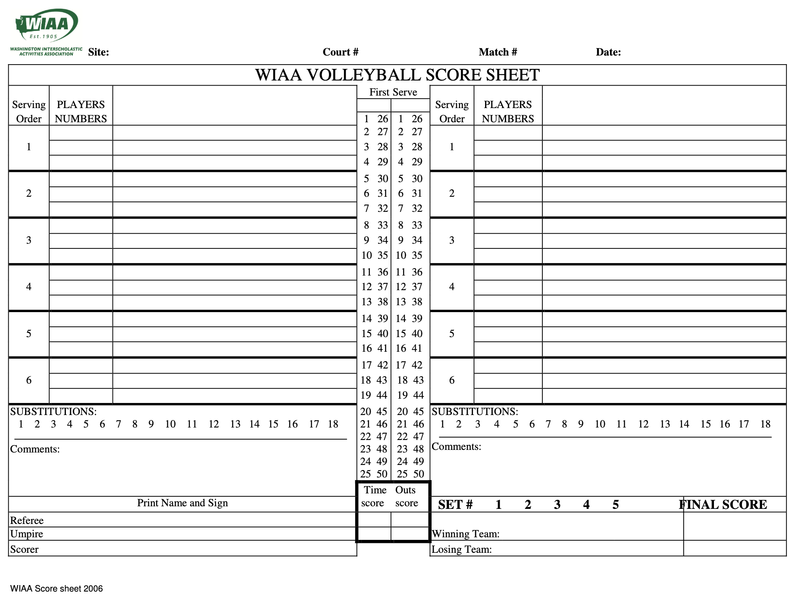
Before the match: Example Scoresheet
1.
2.
3.
4.
Woodinville Highschool
Main
Varsity
10/27/24
L =
a =
L =
a =
5.
7.
6.
5.
Hazen
7.
Woodinville
The red lettering are examples of what and where the information is filled in.
The purple lettering indicates recommendations that are not requirements.
The blue numbers correspond the the checklist on the previous slide.
11.
Alex Tom
8.
Alexa Tommie
9.
Kristine Petesch
10.

Slide 5
Before the match:
Filling out the Scoresheet and the Libero tracking Sheet
Libero Tracking Checklist:
  As the teams do not switch sides at this time, fill in the team names for the first 4 sets of a best 3 of 5 match on each side that matches the scoresheet and where the teams are warming up. Double check with the R2 if there is concern that they may change before the match starts (more relevant to post-season or tournament play).
  Recommendation 1: Indicating which team is serving for each of the first 4 sets of a best 3 of 5 match can help keep the match flowing quickly and help to support the scorekeeper. Typically, writing an S next to the serving team is sufficient or circling the S on the new libero tracking sheet is also commonly done.
  Recommendation 2: Indicating the number of the libero for each set can also be useful if there is a need to replace the libero. This is also helpful to support the scorekeeper, as this information is not required on a scoresheet. There is a place for this information on the new libero tracking sheets, but not on the old sheets. You can add it even if there is not a place labelled for it.

Slide 6
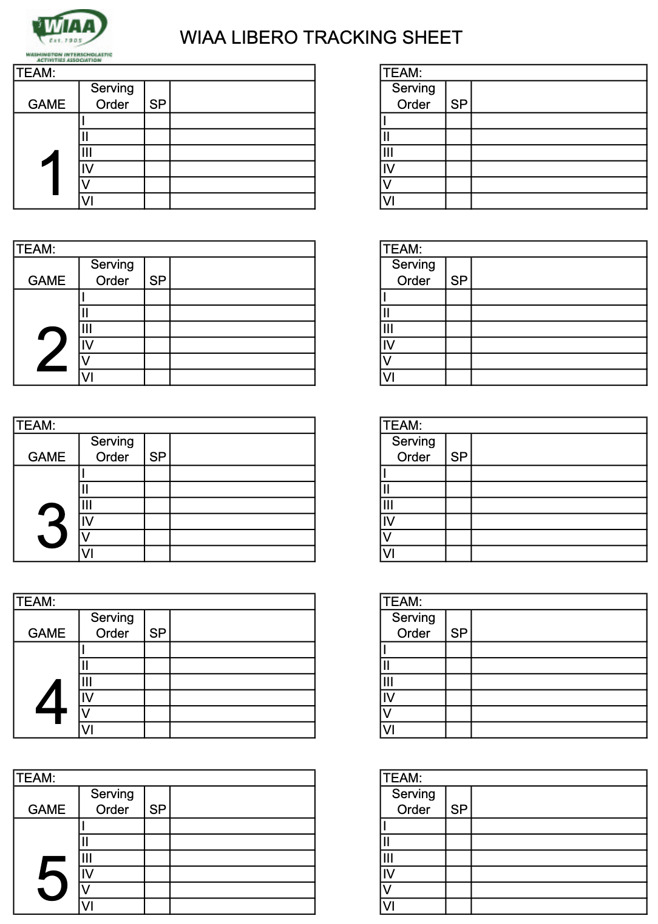
Before the match:
Example Libero Tracking Sheet
(old libero tracking sheet that some schools may still be using)
1.
3.
1.
3.
2.
S
Woodinville
L =
Hazen
L =
2.
L =
Woodinville
L =
S
Hazen
The red lettering are examples of what and where the information is filled in.
The purple lettering indicates recommendations that are not requirements.
The blue numbers correspond the the checklist on the previous slide.
2.
S
Woodinville
L =
Hazen
L =
Woodinville
2.
L =
L =
S
Hazen
Woodinville
L =
Hazen
L =

